Slide 1
Hotel management system
L003 Shivam Batra
L008 Harsh Gulwani
L013 Soham Joshi
L021 Manav Puria

Slide 2
iNDEX
Abstract
Introduction
Scope of the Project
Organization
Research question
Block Diagram of Functionalities
Problem Statement
Classes and their members
Class diagram
Use case diagram
Activity diagram
Sequence diagram
Object- Oriented concepts Implemented
Algorithm
Flowchart
16. Code in C++
17. Output Screenshots of all Functions
18. List of Errors obtained and their resolution
Scope of Improvement ( Plan to improve it)
References/List of research papers, books, white papers referred

Slide 3
1.ABSTRACT
This project explores how C++ programming can be used to make a secured hotel management system. To keep up with the modern technology and be informed about all the activities going on in the hotel, it has become crucial for managers to have a digital hotel management system which holds and maintains all important information needed to run the hotel. This project leverages core functionalities of object oriented programming the project uses these functionalities to help the manager in reservation management, guest check-in/check-out procedures, room allocation, restaurant and billing. Guest security holds the highest importance in the system, therefore, techniques like data hiding, encapsulation were implemented. The project developed a user-friendly interface is developed to streamline the interaction between the manager and the system. This project aimed at developing a program to make the daily tasks of managers storing information , managing data and fetching information from the database.
DISCLAIMER: Customer is never in contact with the program; the manager is the intermediary.

Slide 4
2. INTRODUCTION
As the manager of a hotel, they must oversee a wide range of activities while also protecting sensitive guest data. The sheer volume of operations in a hotel, along with the requirement for painstaking attention to detail, requires new approaches to maximize efficiency and expedite management processes. Recognizing these problems, our project aims to transform hotel administration by delivering a comprehensive solution that consolidates all key data and processes into a single, easily accessible platform. This platform acts as a centralized hub, allowing the management to efficiently monitor and handle many areas of the hotel's operations even when they are not physically present on-site at all times.

Slide 5
3. Scope of the project
Labor Cost Reduction: By simplifying and automating key managerial operations, the initiative helps the hotel minimize its dependency on manual labor, potentially saving money.
Time Efficiency: The project improves time efficiency by centralizing data and operations, allowing managers to access information and complete tasks more quickly and effectively. This time efficiency not only improves the hotel's operations, but it also helps to increase general productivity and economic efficiency in the hospitality business.
Data Security Assurance: The project uses strong security methods such as double-step verification to protect sensitive guest data from unwanted access or breaches. [1] This assurance of data protection is critical.

Slide 6
4. ORGANISATION
Storyline
Beginning your day with the familiar routine of logging into the hotel management system, you ensure smooth operations by verifying your credentials. Once authenticated, you're greeted with options to navigate through the various modules. Opting to start with the reception module, you seamlessly guide guests through the check-in or check-out process, meticulously updating databases with each interaction. Transitioning to the restaurant module, you effortlessly retrieve menus, take orders, and manage billing, ensuring guests enjoy a delightful dining experience. As the day progresses, you deftly navigate between tasks, adeptly addressing guest needs and ensuring efficient operations.

Slide 7
5. Research question
How can Object-Oriented Programming (OOP) principles be used to enhance the efficiency and security of hotel management systems ?
What specific design patterns and practices are most effective in developing a robust and secure OOP-based hotel management system?

Slide 8
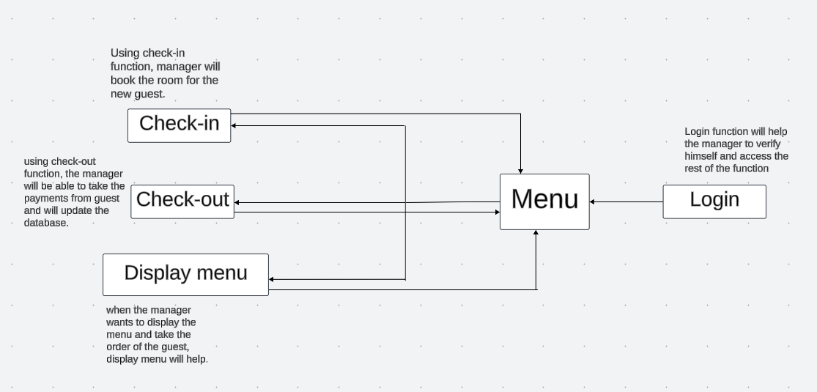
Block Diagram

Slide 9
7. Problem statement
In the hospitality industry, maintaining a hotel effectively while protecting sensitive guest data presents considerable hurdles. Traditional hotel management systems frequently lack the sophistication and resilience required to efficiently streamline operations and protect data. The lack of a unified platform for managing multiple parts of hotel operations leads to inefficiencies, higher labor costs, and security breaches [1]. Furthermore, manual processes and fragmented data storage make it difficult for managers to obtain vital information quickly and make informed decisions. Thus, there is a compelling need to create an effective and safe hotel management system based on Object-Oriented Programming (OOP) concepts. This system should incorporate OOP concepts to optimize resource consumption, improve data security, and serve as a consolidated platform for hotel operations administration. Addressing these difficulties will result in increased efficiency, cost savings, and guest satisfaction in the hotel industry.

Slide 10
Improvements that had to be done
Class name shouldn’t be same as functionality
Change the name of ‘customer’ class
Connect classes in class diagram
Storyline should match with classes
Functionality should be mentioned in steps of Sequence diagram
Activity should represent all the functionality
References in IEEE format

Slide 11
8.Classes and their members
Class 1: Manager
Data Members
manager_name : string
manager_password : string
Members Functions
login()
Class 2: Reception
Data Members
cust_name : string
mobile_no : string
verification_status (flag) : int
customer_index : int
room_type[ ] :string
room_price[ ] : double
no_of_room[ ] : int
room_choice : int
room_no : int
stay_duration : int
room_receipt : double
Members Functions
check-in()
check-out()
get_roomdata()
get_custdata()
verify_cust_data()
update_data()
payment()
Class 3: Restaurant
Data Members
cust_name : string
room_no : int
menu_choice : int
rest_receipt : double
Members Functions
Restaurant() constructor
verify_cust_data()
display_menu()
take_order()
update_cust_data()

Slide 12
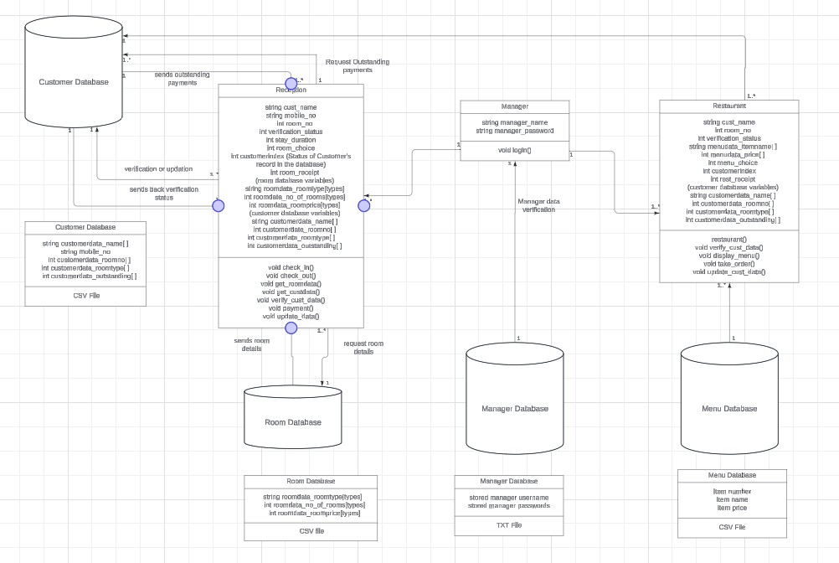
9. Class diagram

Slide 13
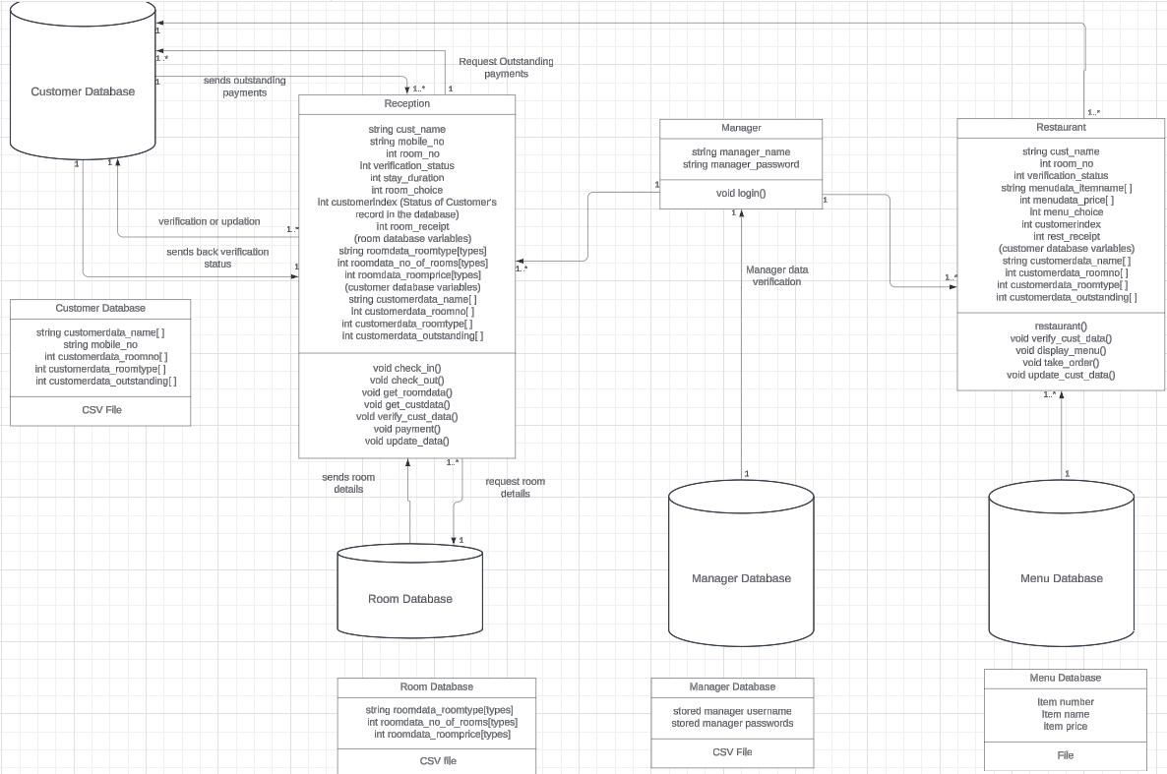
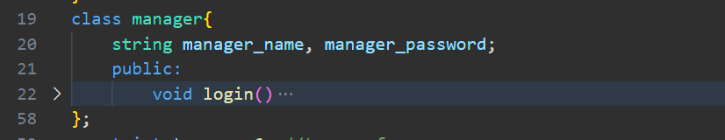

Slide 14
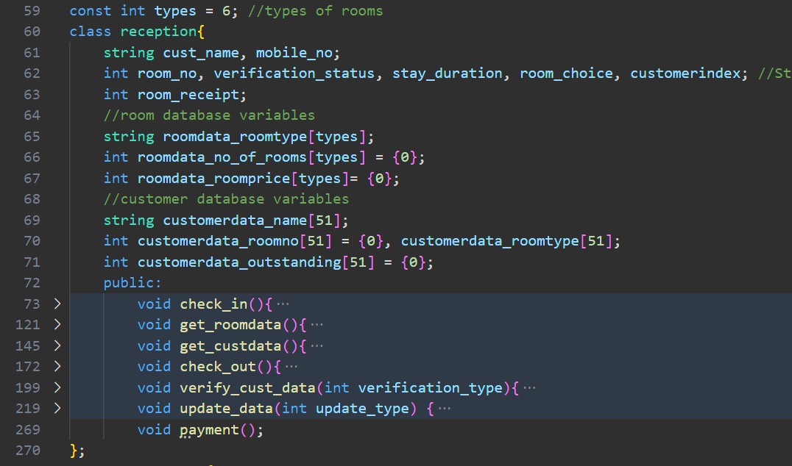

Slide 15
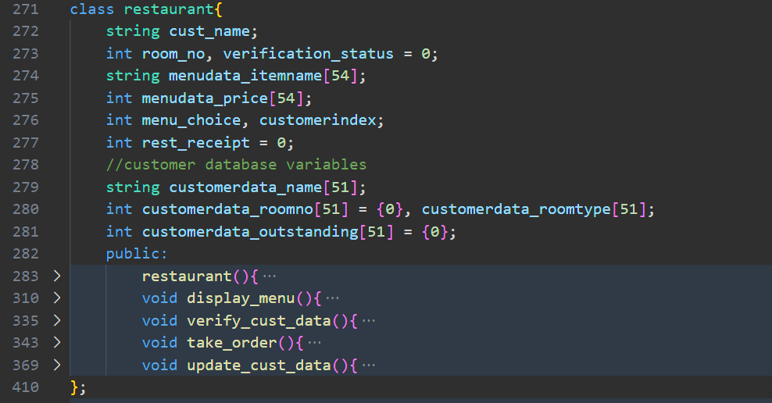

Slide 16
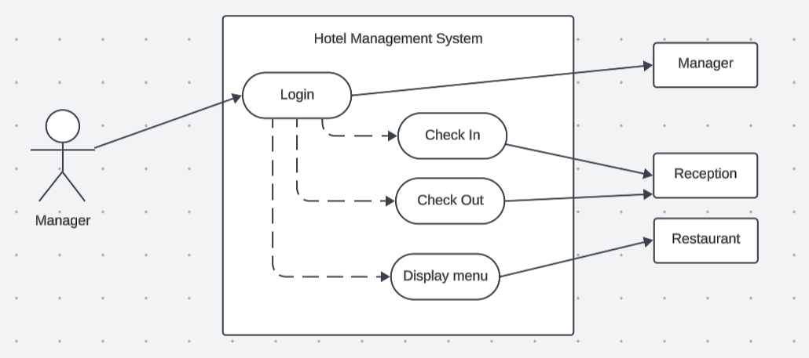
10. Use case diagram

Slide 17
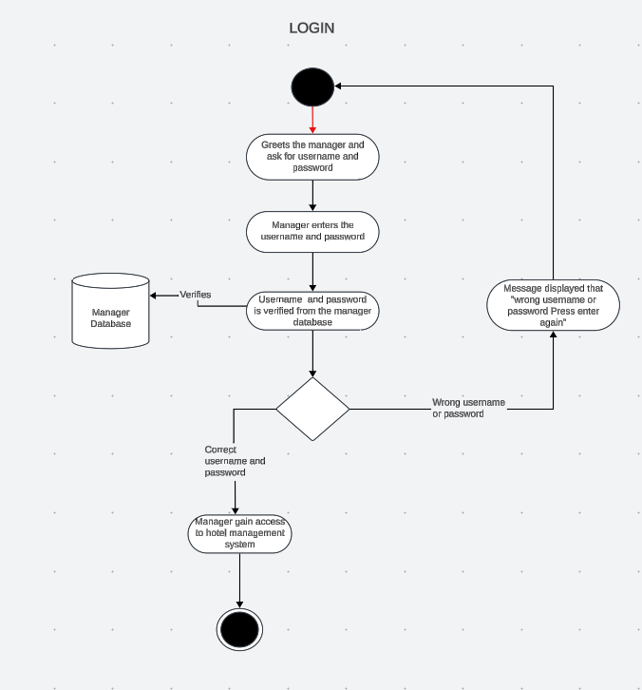
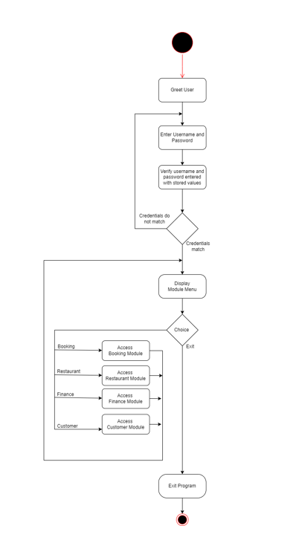
11. Activity diagram
OLDER VERSION

Slide 18
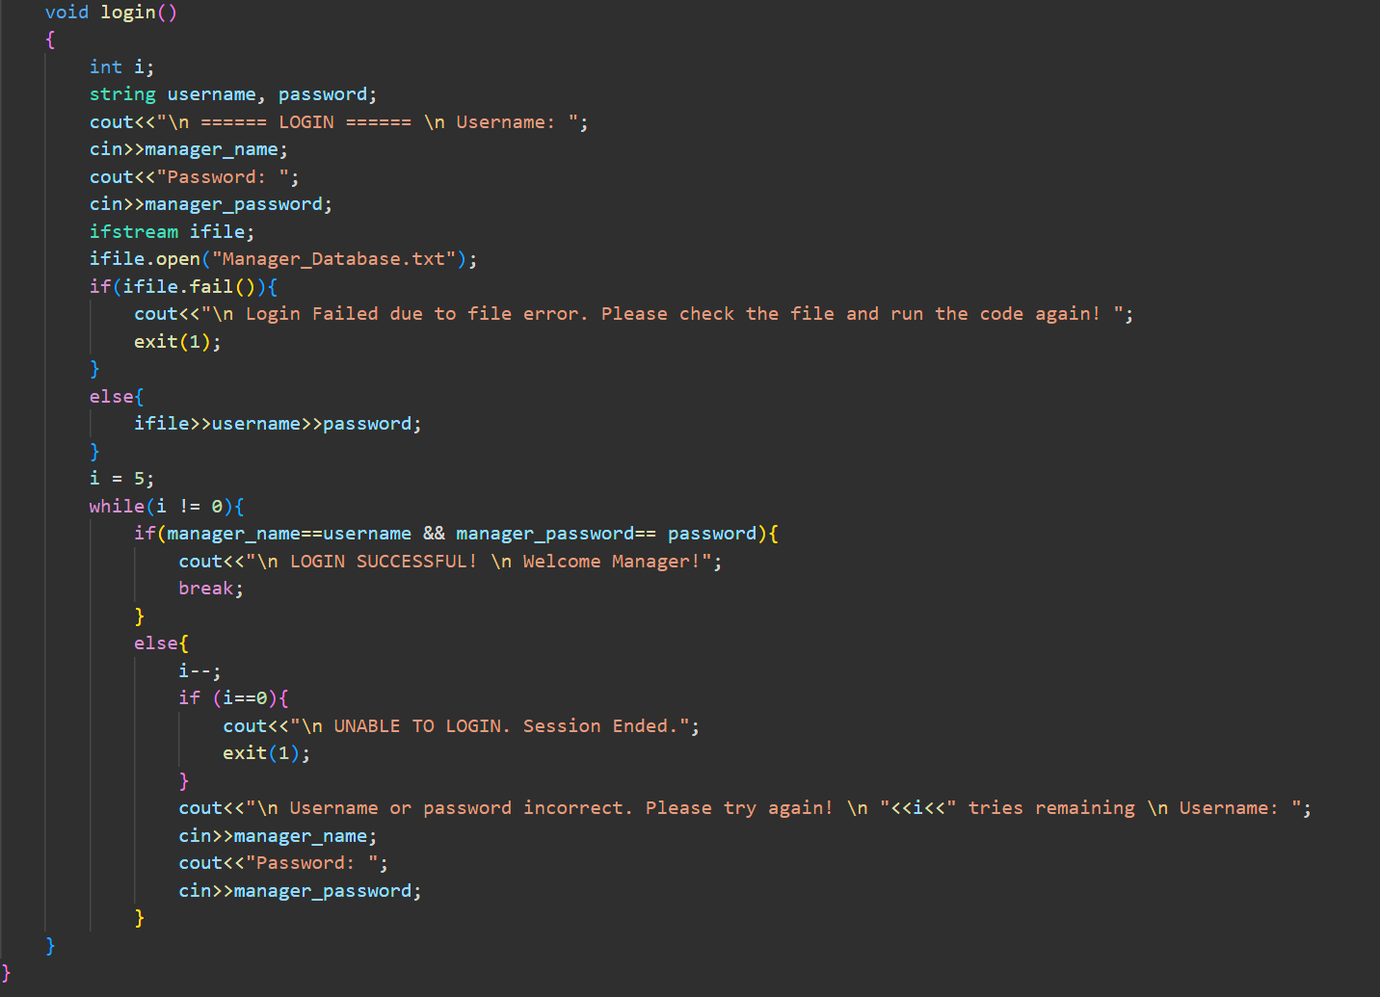

Slide 19
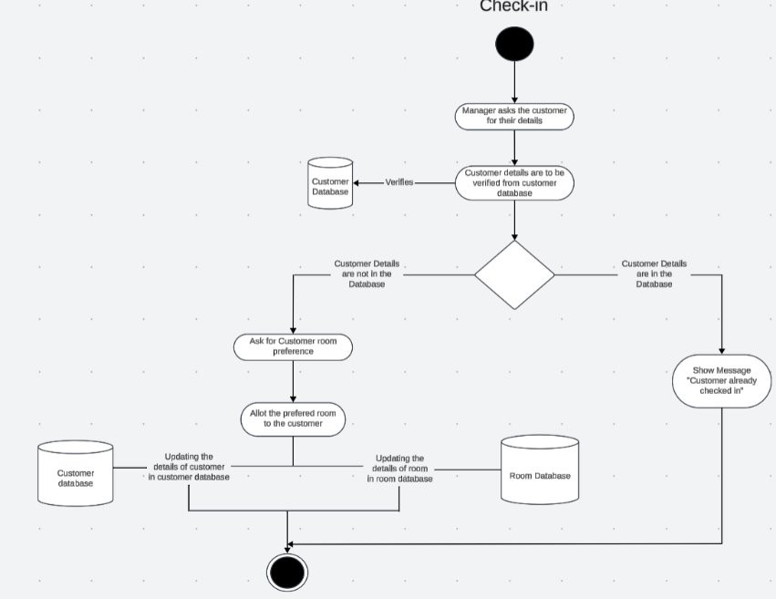
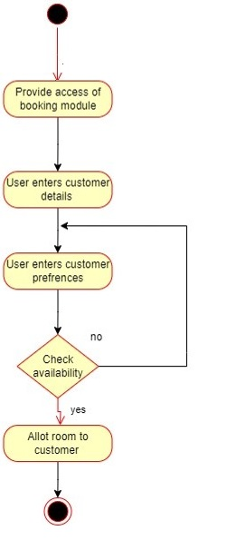
OLDER VERSION

Slide 20
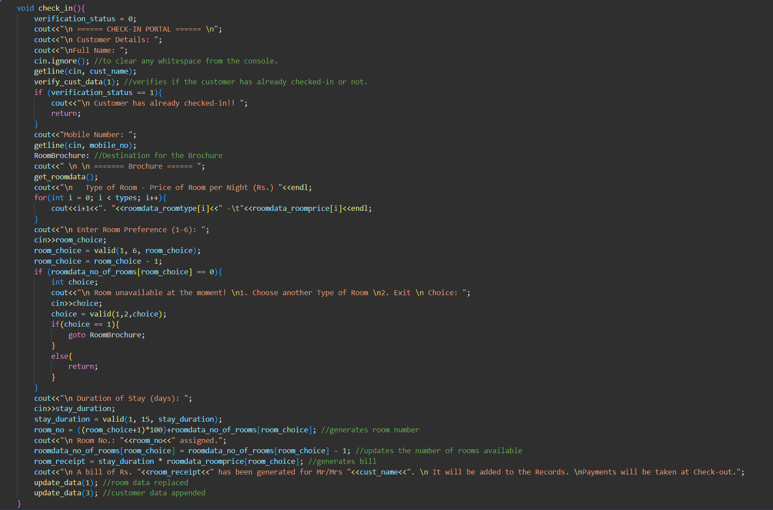

Slide 21
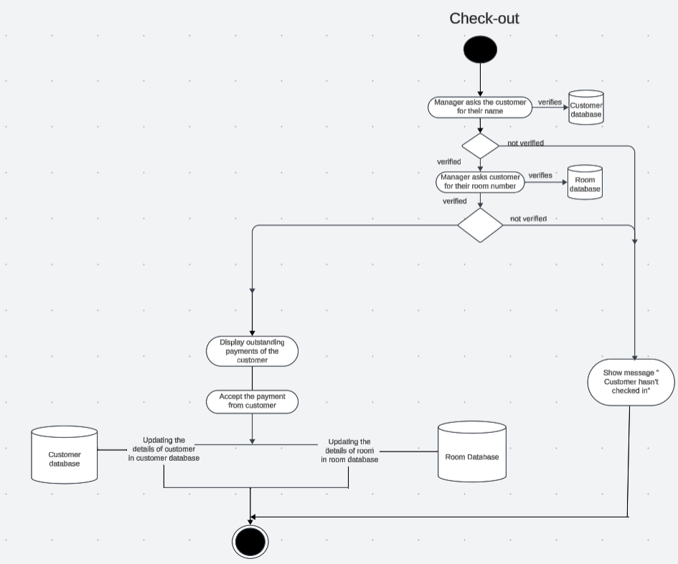
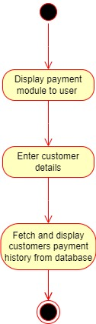
OLDER VERSION

Slide 22
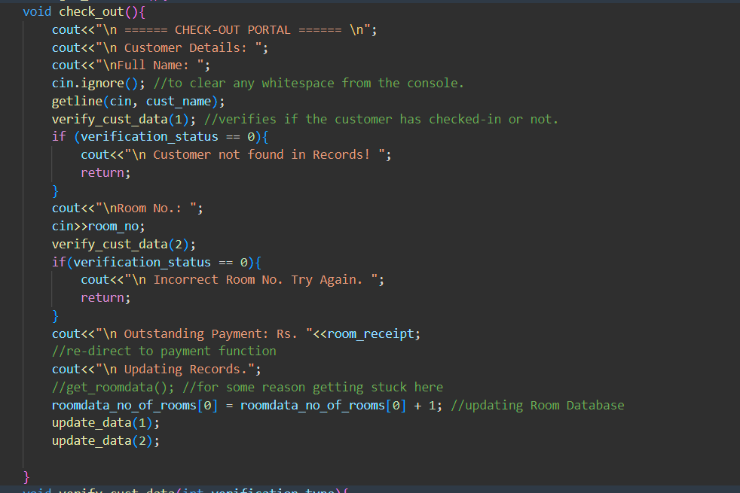

Slide 23
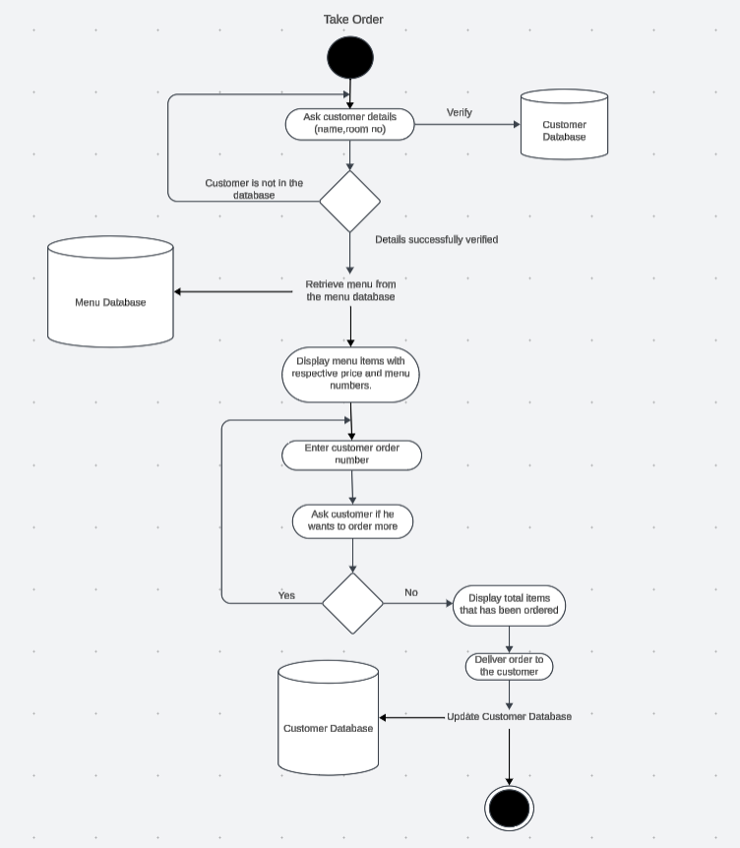
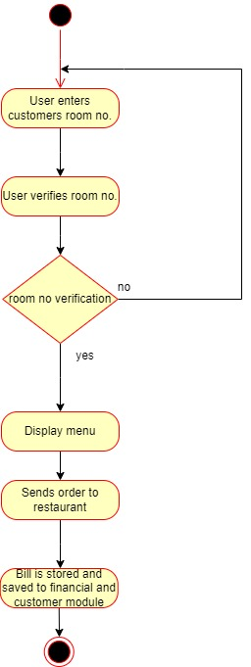
OLDER VERSION

Slide 24
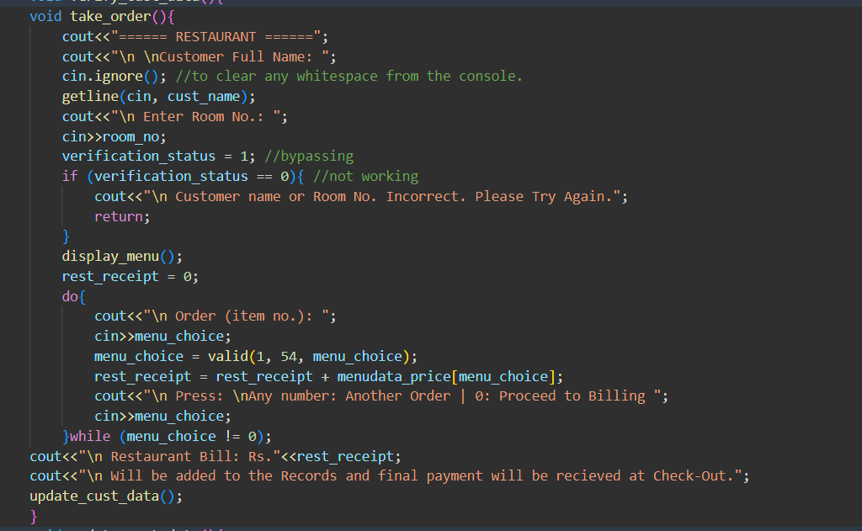

Slide 25
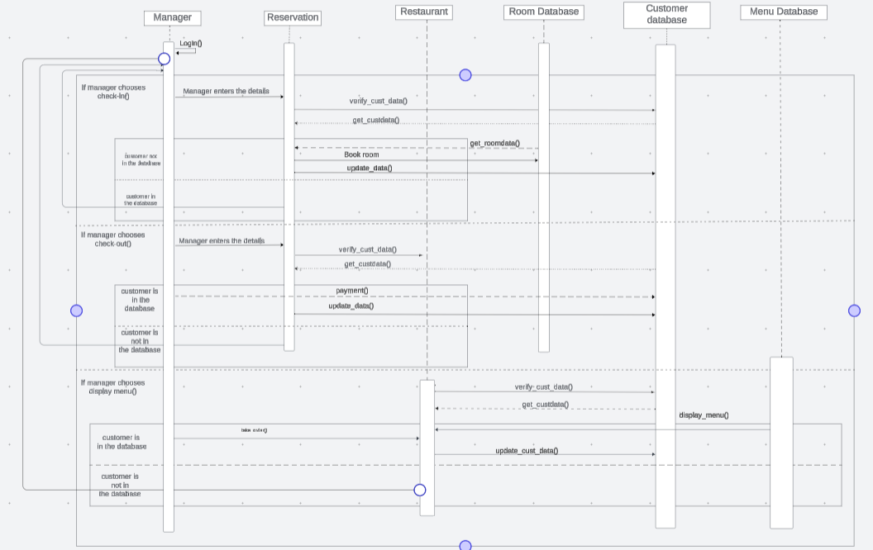
12. Sequence diagram

Slide 26
13. Object-Oriented concepts
Scope resolution operator
Class
Objects
Data Abstraction
Encapsulation
Polymorphism
Dynamic Binding
Message Passing
Constructors
File handling
Template
Data extraction from CSV file

Slide 27
14.Algorithm
START
Welcomes the user(manager) and displays login screen.
The manager enters the username and password for his/her verification.
If the username and password are correct then go to step 5 and if either of the username or password is incorrect then go to step 2.
The user is given a choice to select any of the following module
Reception module (Go to step 6)
Restaurant module (Go to step 17)
Exit Program (Go to step 24)

Slide 28
RECEPTION module
6) Give option check-in or check-out. If check-in, go to step 7. Else go to step 13
Ask customer for their details. (name)
Check if customer details are in the database:
If yes, then go to step 6
If no, then go to step 9
Ask the customer for their room preferences, and the availability is checked.
If available, go to step10
If not available, go to step 9
Ask duration of their stay and allot room to them. (update room database)
Show room receipt ,update Customer Database and then exit the reception module.
(go to step 5)
12) Ask customer for their details. (name,room_no)
Check if customer details are in the database:
If yes, then go to step 14
If no, then go to step 6
Display his/her outstanding payments
Update Customer Database after taking payment.
Wish them good day!
(go to step 5)

Slide 29
Restaurant module
17) User verifies the customer name and room number from the database
18) Menu is displayed, after retrieving it from Menu Database
19) User takes the customer's order and enters it in the program
20) User is asked for ‘another order’ (any number) or if ‘order is over’ (0).
21) If another order:
Go to step 19
Else if order is over:
Go to step 22
22) The bill is stored as outstanding payment in customer database.
23) Restaurant Module is exited (Go to step 5)

Slide 30
Exit program
24) Print an Exit program statement
25) END

Slide 31
Future SCOPE
Improve File Management (Debug Errors).
Include Destructor and Dynamic Memory allocation to make memory management efficient.
Introduce a payment portal for the payment at check-out.
Introduce a Manager Hierarchy with selective access to classes.
Replace CSV Files with MySQL Files for Database for better file management.

Slide 32
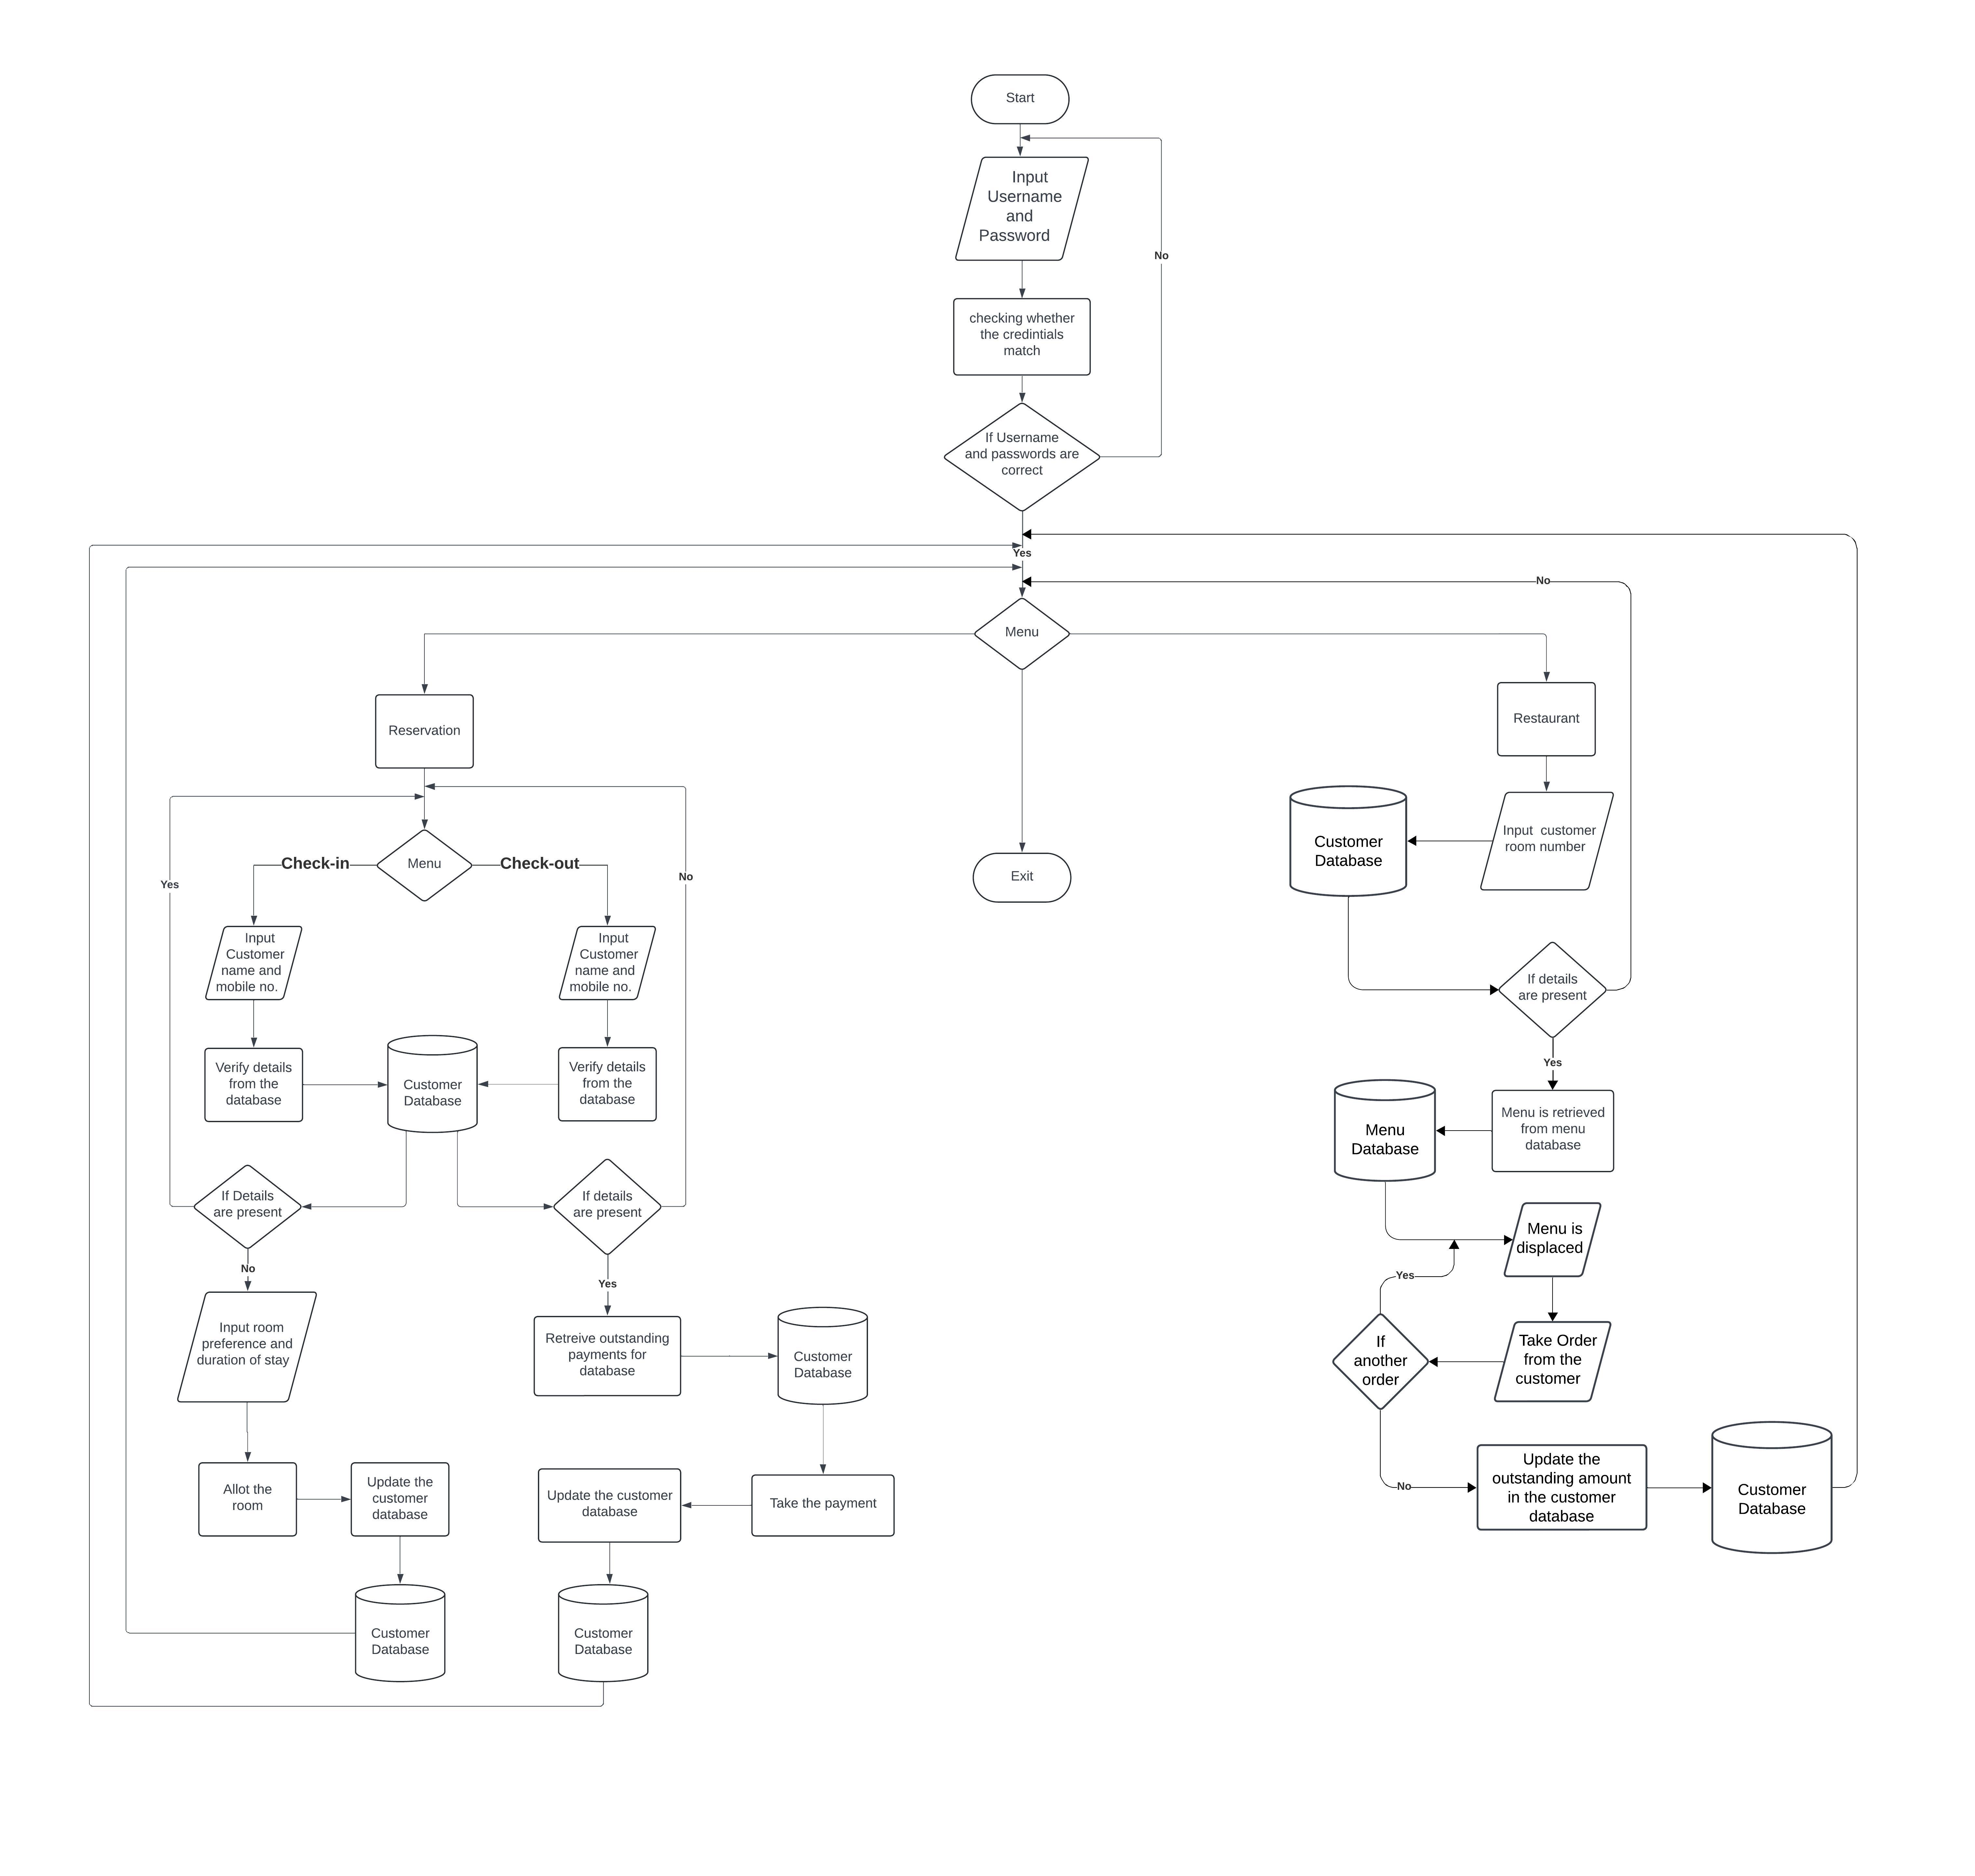
FLOWCHART

Slide 33
REFERENCES
​[1] | ​TIMESOFINDIA, "THE TIMES OF INIDA," 24 NOVEMBER 2023. [Online]. Available: https://timesofindia.indiatimes.com/gadgets-news/taj-hotel-data-breach-what-the-company-has-to-say-ransom-demanded-conditions-set-by-hackers/articleshow/105461155.cms. [Accessed 4TH APRIL 2024].
​[2] | ​T. C. L. a. R. Laganiere, "class and object," in Object-Oriented Software Engineering, New Delhi, Tata Mc Graw-Hill, 2004, pp. 27-29.
​[3] | ​T. C. L. a. R. Laganiere, "Abstraction," in Object-Oriented Software Engineering, New Delhi, Tata Mc Graw-Hill, 2004, pp. 27-29.
​[4] | ​E. Balagurusamy, "file," in Object Oriented Programming With C++, noida, Tata Mc Graw-Hill, 2008, p. 334.
​[5] | ​E. Balagurusamy, "Encapsulation," in Object Oriented Programming With C++, Noida, Tata Mcgraw, 2008, pp. 8-9.
​[6] | ​E. Balagurusamy, "destructor," in Object Oriented Programming With C++, noida, Tata Mc Graw-Hill, 2008, p. 144.

Slide 34
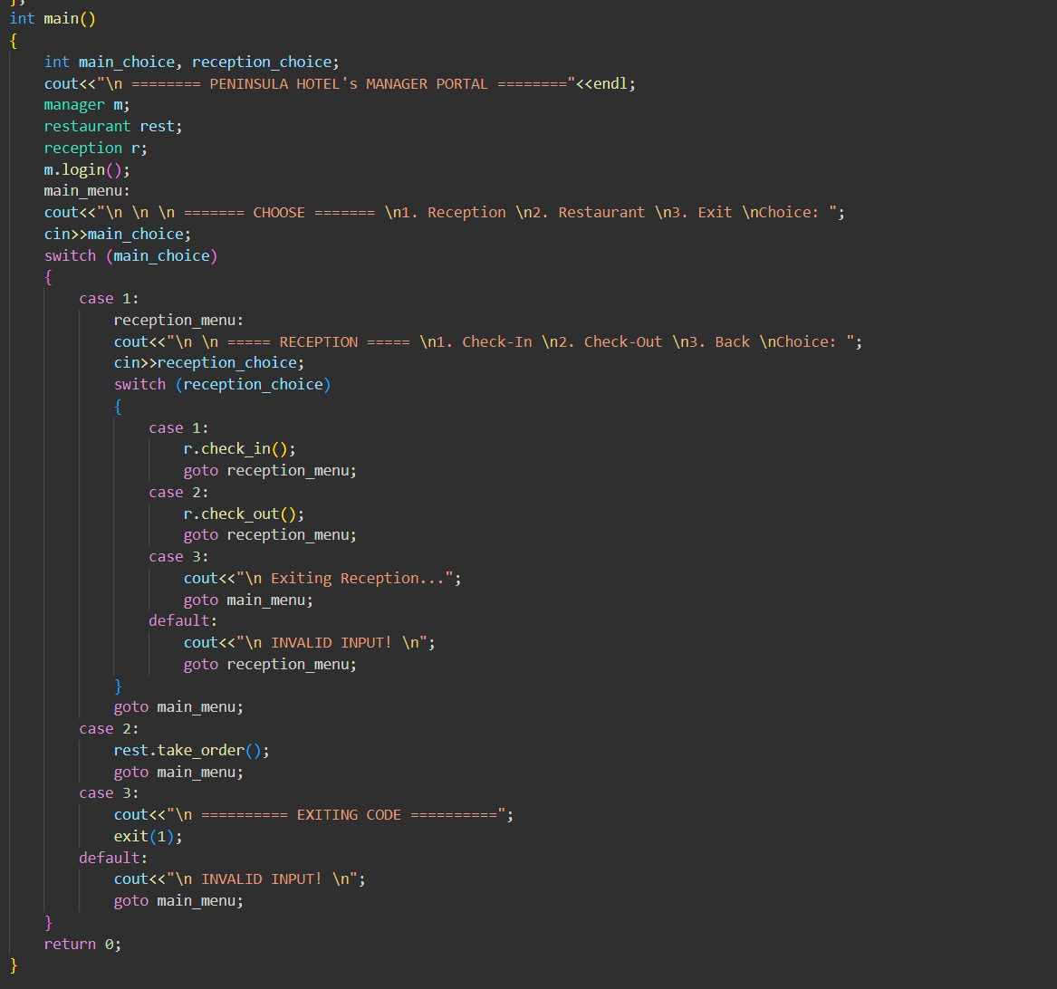
Int main( )

Slide 35
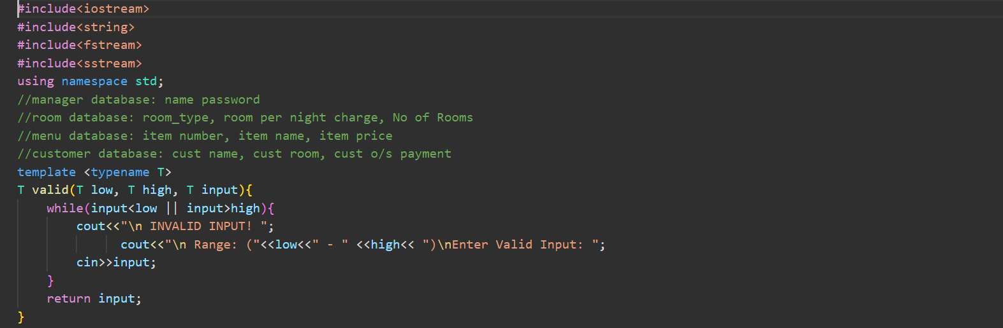
LIBRARIES AND GLOBAL TEMPLATE

Slide 36
LOGIN( )

Slide 37
CHECK_IN( )

Slide 38
CHECK_OUT( )

Slide 39
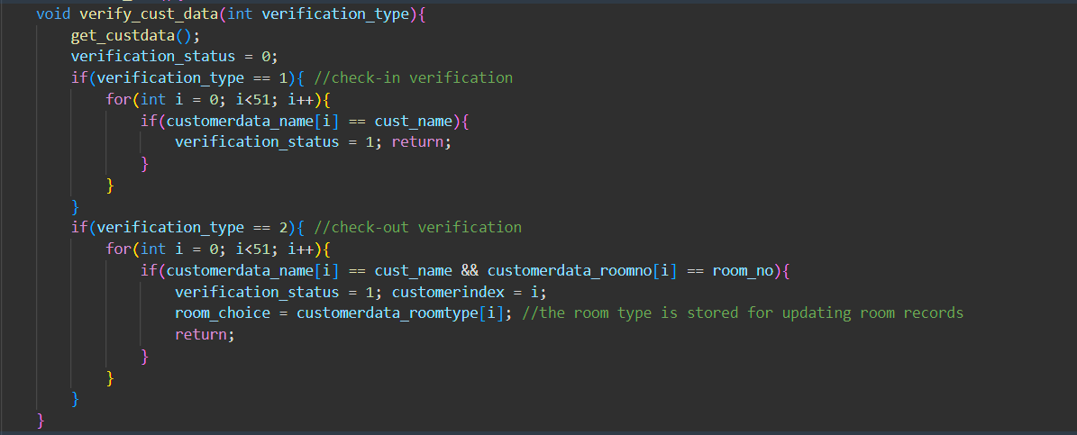
VERIFY_CUST_DATA( )

Slide 40
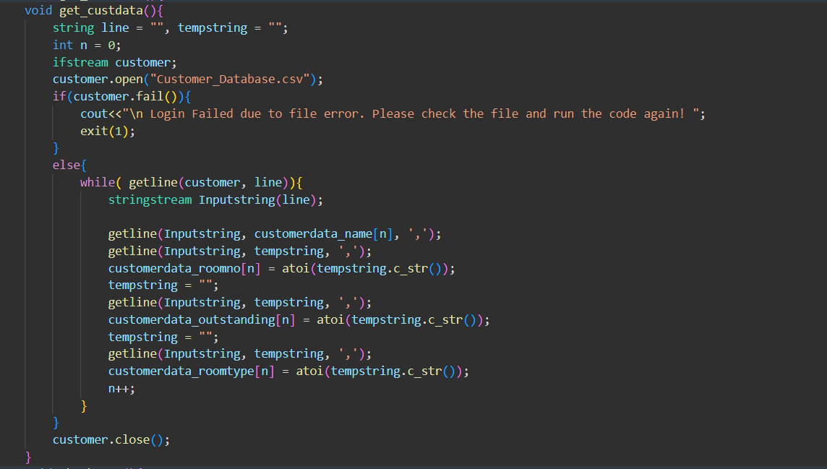
GET_custdata( )

Slide 41
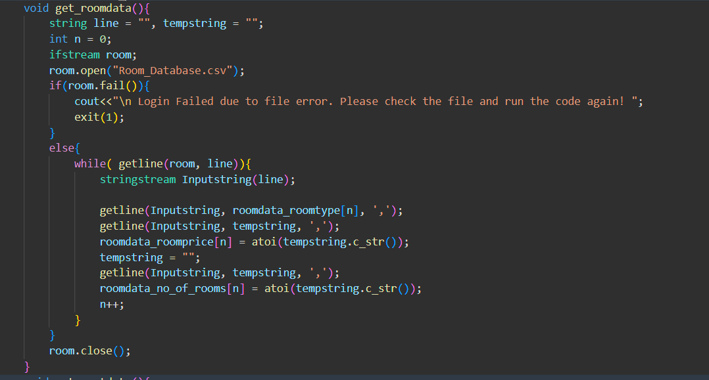
Get_roomdata( )

Slide 42
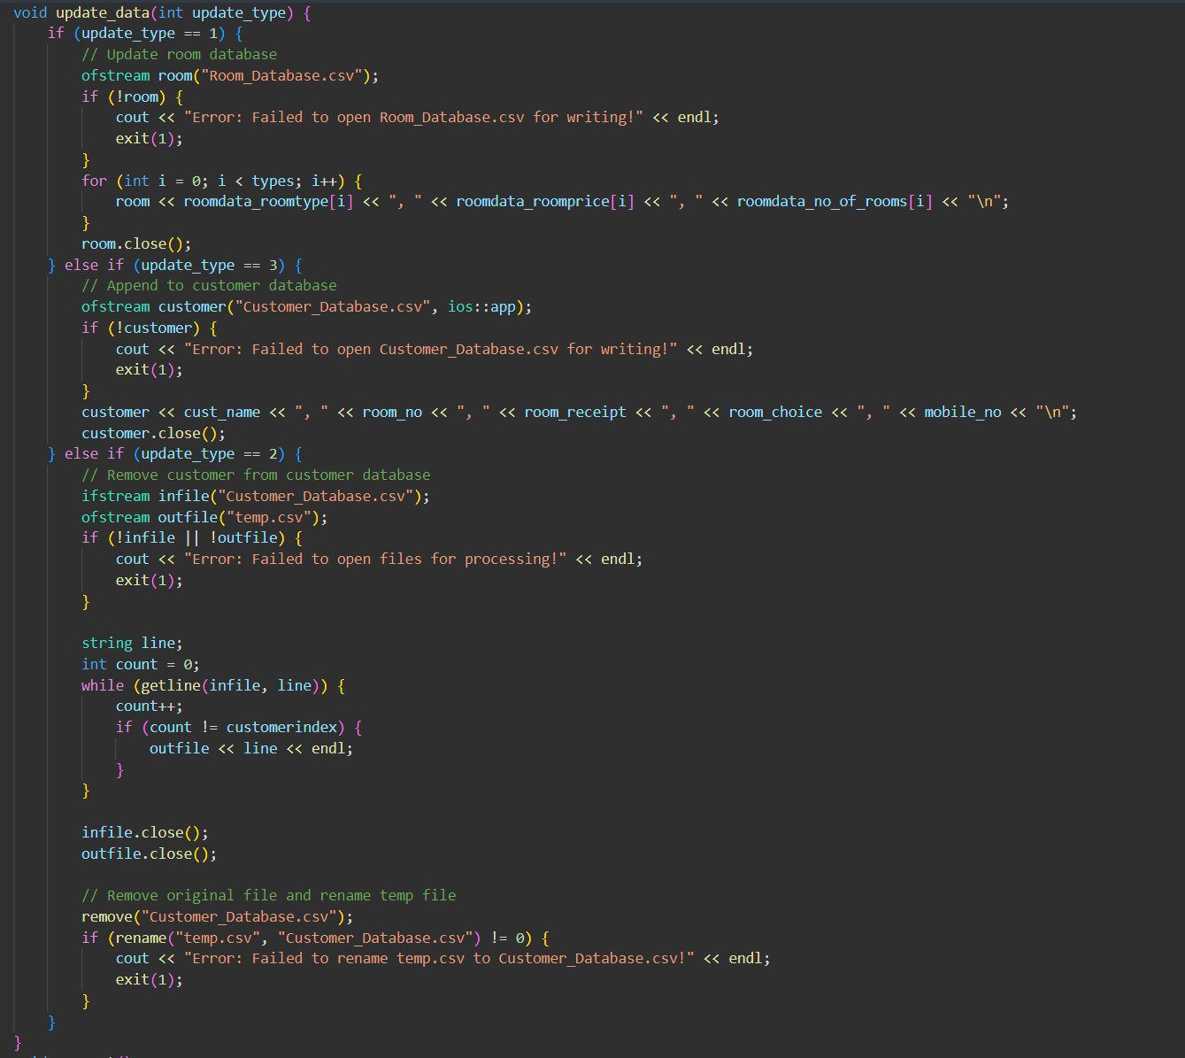
Update_data

Slide 43
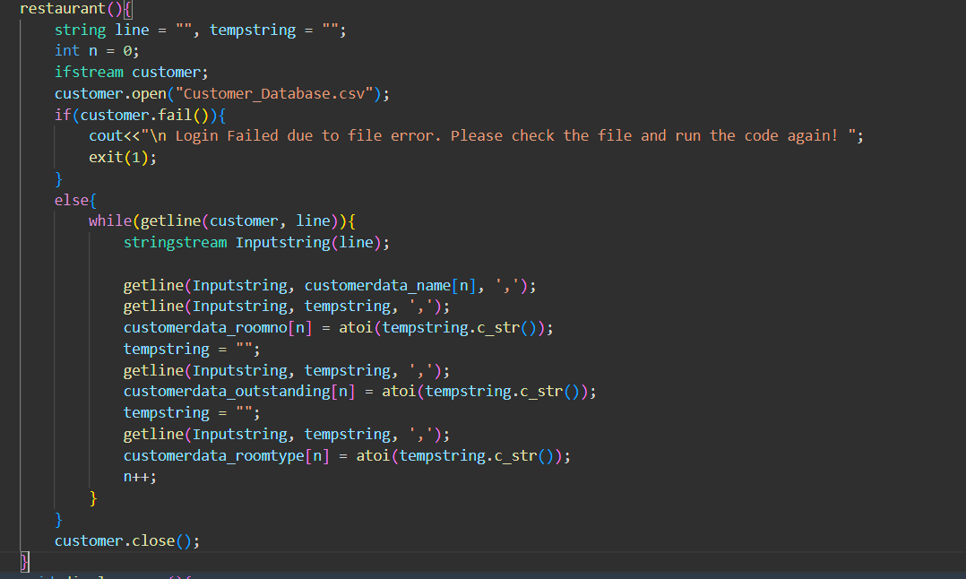
Restaurant constructor

Slide 44
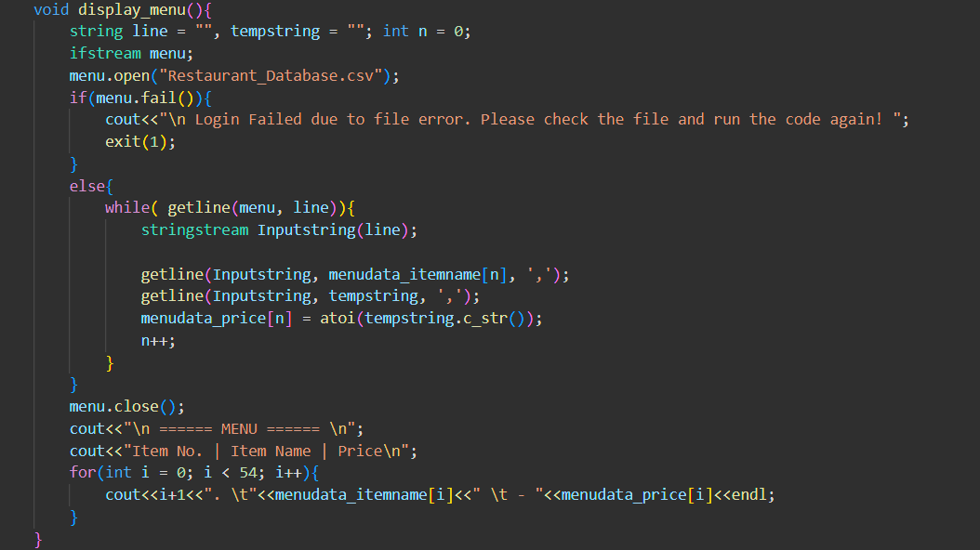
Display_menu( )

Slide 45
Take_order( )

Slide 46
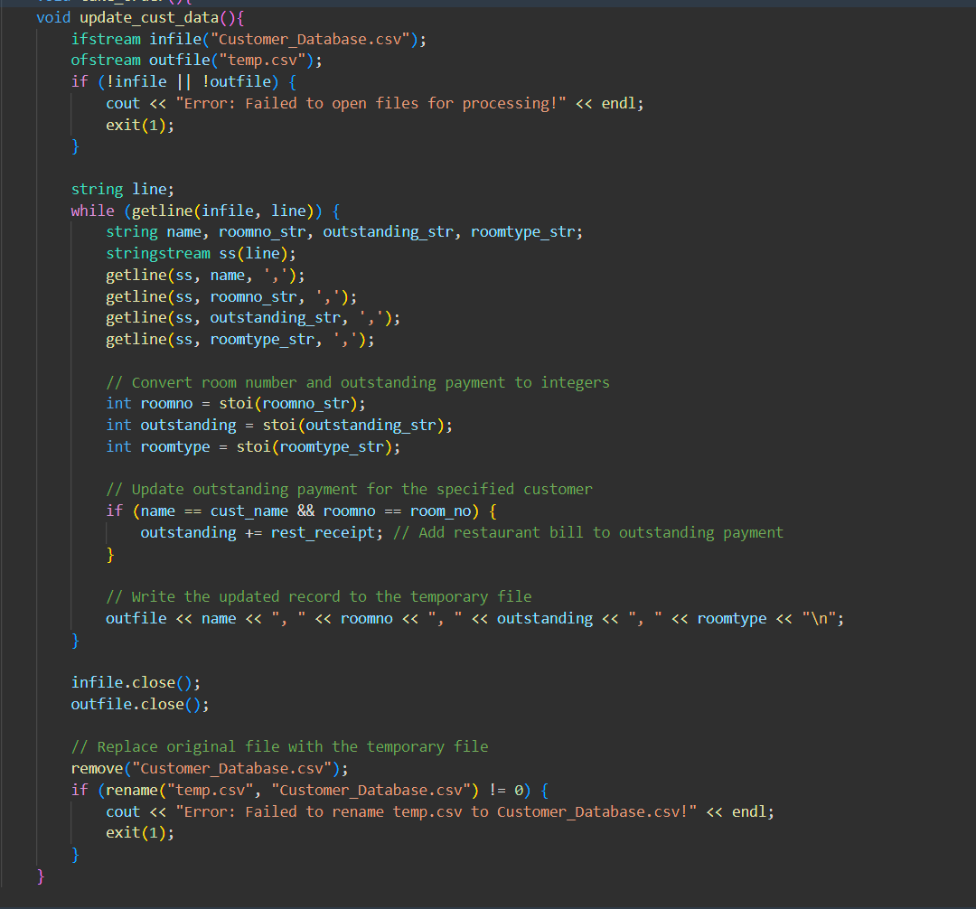
Update_cust_data( )

